Slide 1




EFFECTIVE WRITING SKILLS
By : Prof. Roshni J. Patel

Slide 2


UNIT - 1
Vocabulary and Grammar

Slide 3

  Collocations
  Collocations are combinations of words that frequently occur together in natural language.
  Mastering collocations can help IT students communicate more effectively, whether writing reports, giving presentations, or collaborating on projects.
  For example:
        • "Install software" (not "fix software")
        • "High-speed internet" (not "fast-speed internet")

Slide 4
  Collocations can be divided into several categories:
      Verb + Noun: write code, launch an app.
      2. Adjective + Noun: user-friendly interface, critical update.
      3. Noun + Noun: data breach, system failure, cyber security.
      4. Adverb + Adjective: highly secure, fully operational.
      5. Verb + Adverb: function seamlessly, connect remotely.

Slide 5
Common IT Collocations with Meanings
    • Hardware & Software:
      Install drivers: To set up essential software for hardware to function.
      Format a disk: To prepare a storage device for use by erasing all data and setting up a file system.
      Optimize performance: To adjust settings to make a system run more efficiently.
      Backup files: To create copies of important data to prevent loss.
    • Networks & Security:
      Secure a network: To protect a network from unauthorized access.
      Monitor traffic: To track data flow within a network for analysis or security purposes.
      Reset a password: To change a password, often for security reasons.
      Authenticate users: To verify the identity of users accessing a system.

Slide 6
    • Programming & Development:
      Refactor code: To restructure existing code without changing its behavior to improve efficiency.
      Implement features: To integrate new functionalities into a software application.
      Resolve conflicts: To fix issues arising from overlapping or inconsistent code changes.
      Compile a program: To convert source code into executable code.
    • User Interaction:
      Provide feedback: To give responses or suggestions to improve a system or application.
      Submit a query: To enter a search term or request in a database or search engine.
      Customize settings: To change preferences in an application or system.
      Log out securely: To safely exit a session to prevent unauthorized access.

Slide 7
Why Collocations Matter
Clarity: Using appropriate collocations ensures clarity in communication, especially in a technical environment.
Fluency: Collocations contribute to more natural and professional language use.
Precision: Specific word combinations convey precise meanings essential for technical descriptions.

Slide 8
Exercise 1: Fill in the Blanks Fill in the blanks with appropriate collocations from the list
below:
1. To ensure security, always _______________________________________ your data.
2. Before releasing a new feature, developers must _____________________________
the application.
3. You can __________________________________________ the settings to suit your
preferences.
4. The IT department is responsible for _____________________________ the servers
regularly.
5. The team worked hard to ______________________ the solution before the deadline.
6. It is essential to _____________________________ the software to the latest version.
7. To access the service, first _________________________________ your credentials.
8. Always __________________________ a backup before making significant changes.
9. The network administrator needs to __________________ a connection to the server.
10. Developers aim to ____________________________ code that is clean and efficient.
encrypt
test
customize
maintaining
finalize
update
enter
perform
establish
write

Slide 9
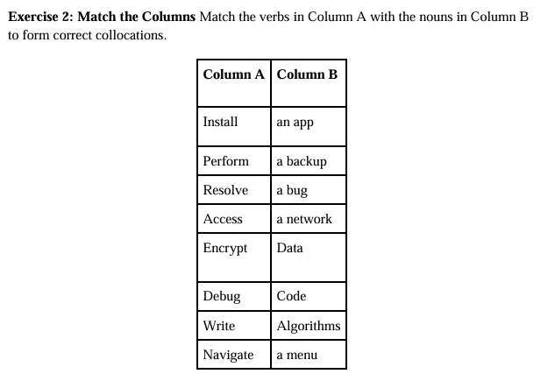

Slide 10
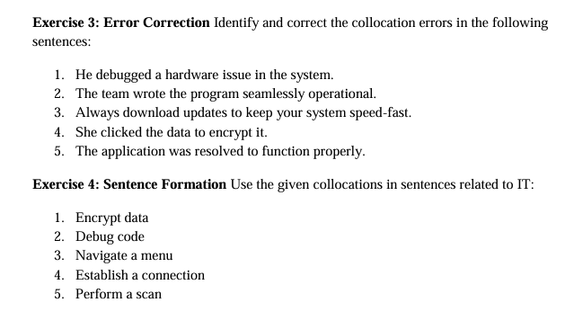
-- troubleshoot
-- made
-- running
-- encrypted the data.
issue
and the application

Slide 11

  Phrases and Idioms
An idiom is a phrase or a group of words that has a non literal (metaphorical) meaning which is accepted in common usage.
Idioms are expressions that demonstrate human behaviors, reactions to certain things, social traits, habits, and traditions.
An idiom's symbolic sense is quite different from the literal meaning or definition of the words of which it is made.
For example, ‘A hot potato’, can be interpreted as a potato that is hot. But the actual (metaphorical) meaning of ‘a hot potato’ is to speak of an issue which many people are talking about and which is usually disputed.
Non-native speakers may not understand idioms easily because their meanings are usually metaphorical.

Slide 12
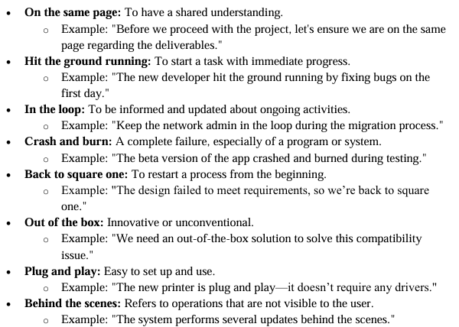

Slide 13
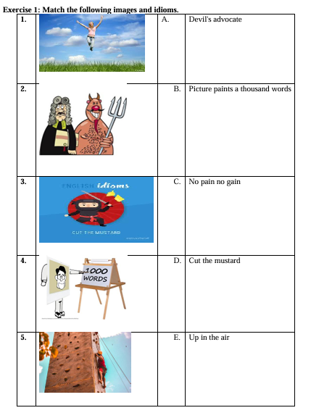

Slide 14
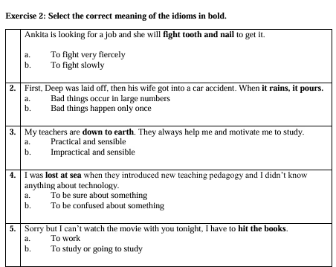


Slide 15
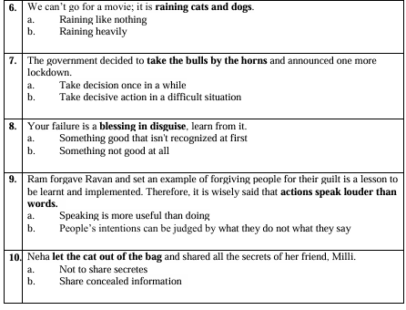

Slide 16
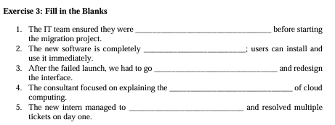
fully prepared
user-friendly
back to the drawing board
benefits
troubleshoot

Slide 17


  Homophones-Homonyms
Homophones :
A homophone is a word that is pronounced the same as another word but differs in meaning.
A homophone may also differ in spelling.
Ex. As in right (correct) and write (to write something on paper)

Slide 18
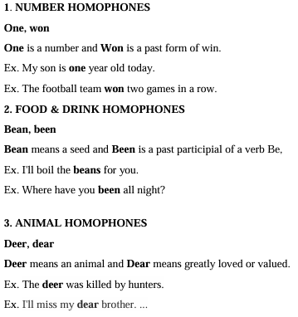
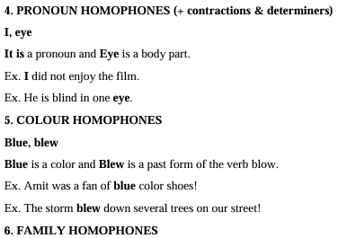

TYPES OF HOMOPHONES :

Slide 19
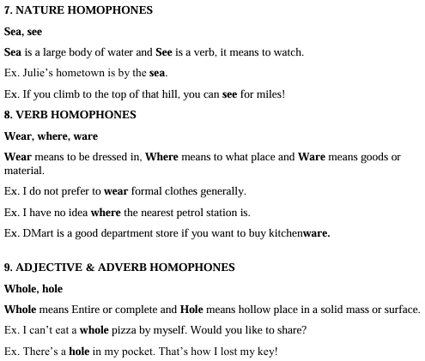

Slide 20
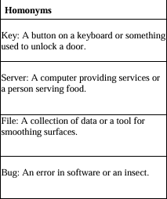
Homonyms:
Homonyms are two words that are spelled the same and sound the same but have different meanings.
• Ex:. I left (verb) my phone on the left (Noun) side of the room.
Examples of homonyms used in sentences:
• The committee chair sat in the center chair.
• The crane flew above the construction crane.
• While they are at the play, I’m going to play with the dog.
• She will park the car so we can walk in the park.

Slide 21
Examples of Homonyms…
  Address - to speak to / location
  Arm - body part / division of a company
  Band - a musical group / a ring
  Bark - a tree's out layer / the sound a dog makes
  Bat - an implement used to hit a ball / a nocturnal flying mammal
  Bright - very smart or intelligent / filled with light
  Current - up to date / flow of water
  Fair - unbiased / beautiful
  Kind - type / gentle
  Match - to pair like items / a stick for making a flame
  Mean - average / not nice
  Ring - a band on a finger / something circular in shape
  Right - correct / direction opposite of left
  Rock - a genre of music / a stone
  Spring - a season / coiled metal

Slide 22
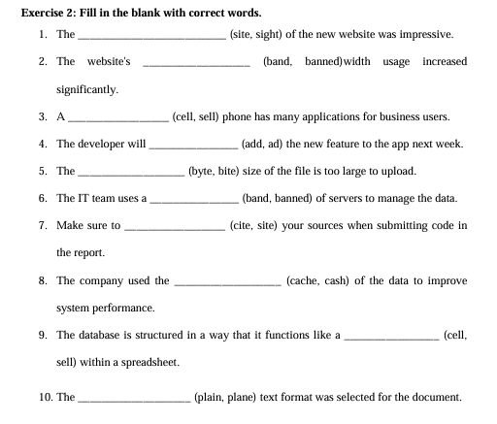
site
bandwidth
cell
add
byte
band
cite
cache
cell
plain

Slide 23
Types of Sentences
Mainly there are three types :
    Function Based
    Structural Based
    Conditional Based

Slide 24
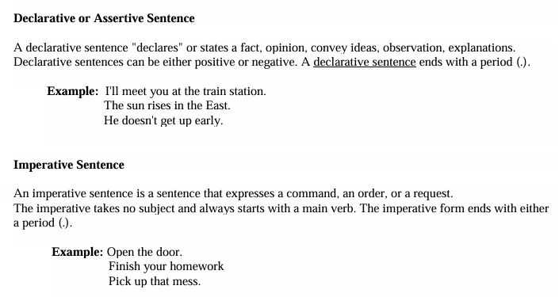
Function Based :-

Slide 25
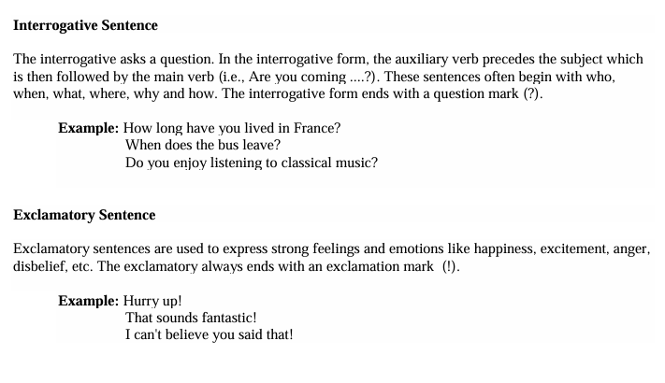

Slide 26
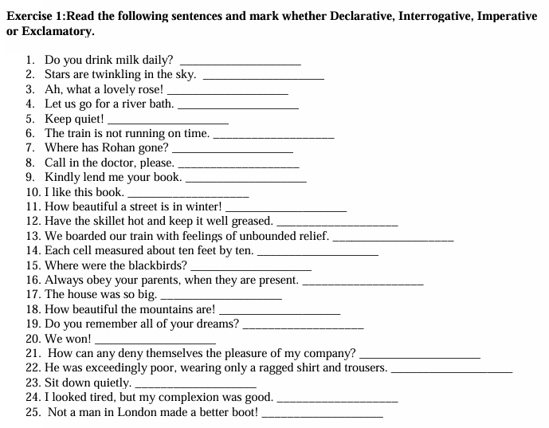

Slide 27
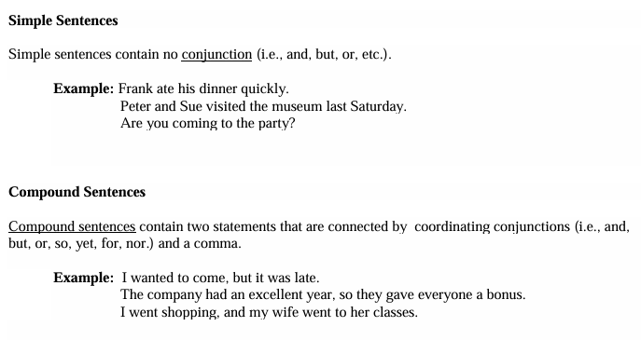
Structural Based

Slide 28
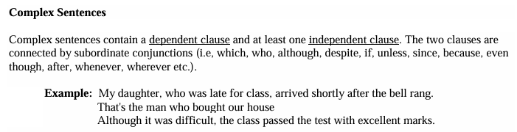
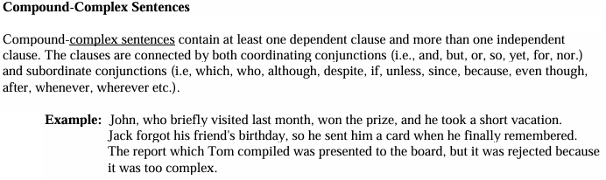

Slide 29
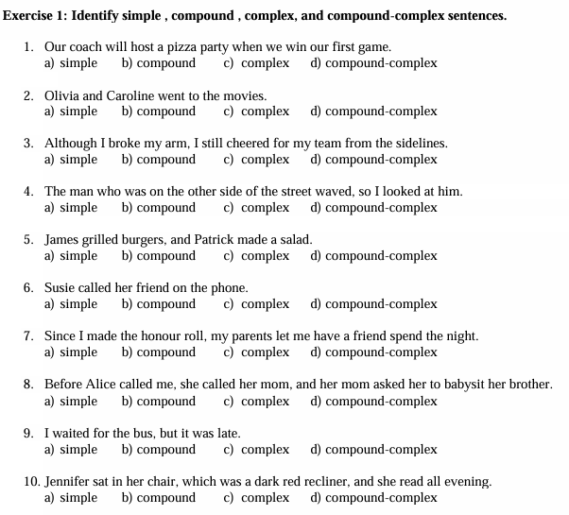

Slide 30
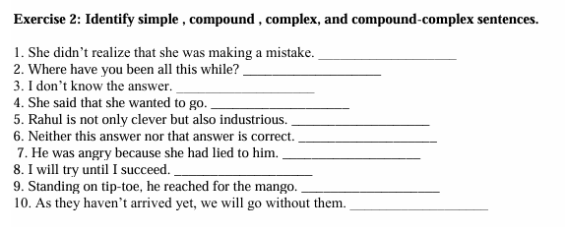

Slide 31
Conditional Based
Conditional Sentences (with Examples)Conditional sentences are used to talk about conditions and their results.
They usually contain two clauses:
• If-clause (condition)
• Main clause (result)⸻
Zero Conditional Use: To express general truths, facts, or scientific laws
Tense:
• If-clause → Present Simple
• Main clause → Present
Example:
        If you heat ice, it melts.
        If students practice daily, they improve their skills.⸻

Slide 32
        2. First Conditional Use: To express real and possible future situations
        Tense:
                If-clause → Present Simple
                Main clause → Future Simple (will + verb)
        Example:
                If you study well, you will pass the exam.
                If it rains, we will stay at home.
        3. Second Conditional Use: To express imaginary, unlikely, or unreal present situations
        Tense:
                If-clause → Past Simple
                Main clause → would + verb
            Example:
                If I were a teacher, I would help every student.
                If she had more time, she would learn new skills.

Slide 33
                4. Third Conditional Use: To express unreal or imaginary situations in the past (often regret)
                Tense:
                If-clause → Past Perfect
                Main clause → would have + past participle
                Example:
                If he had studied harder, he would have passed the exam.
                If we had left earlier, we would have reached on time

Slide 34


THANK YOU

